Slide 1

ECS 351L and 851L : Geospatial Data Science
Lecture 6a: Machine learning applications
Email: jonathan.ryan@duke.edu
Office: 3101 Grainger Hall
Office hours: Mondays and Wednesdays 15:00-16:00

Slide 2
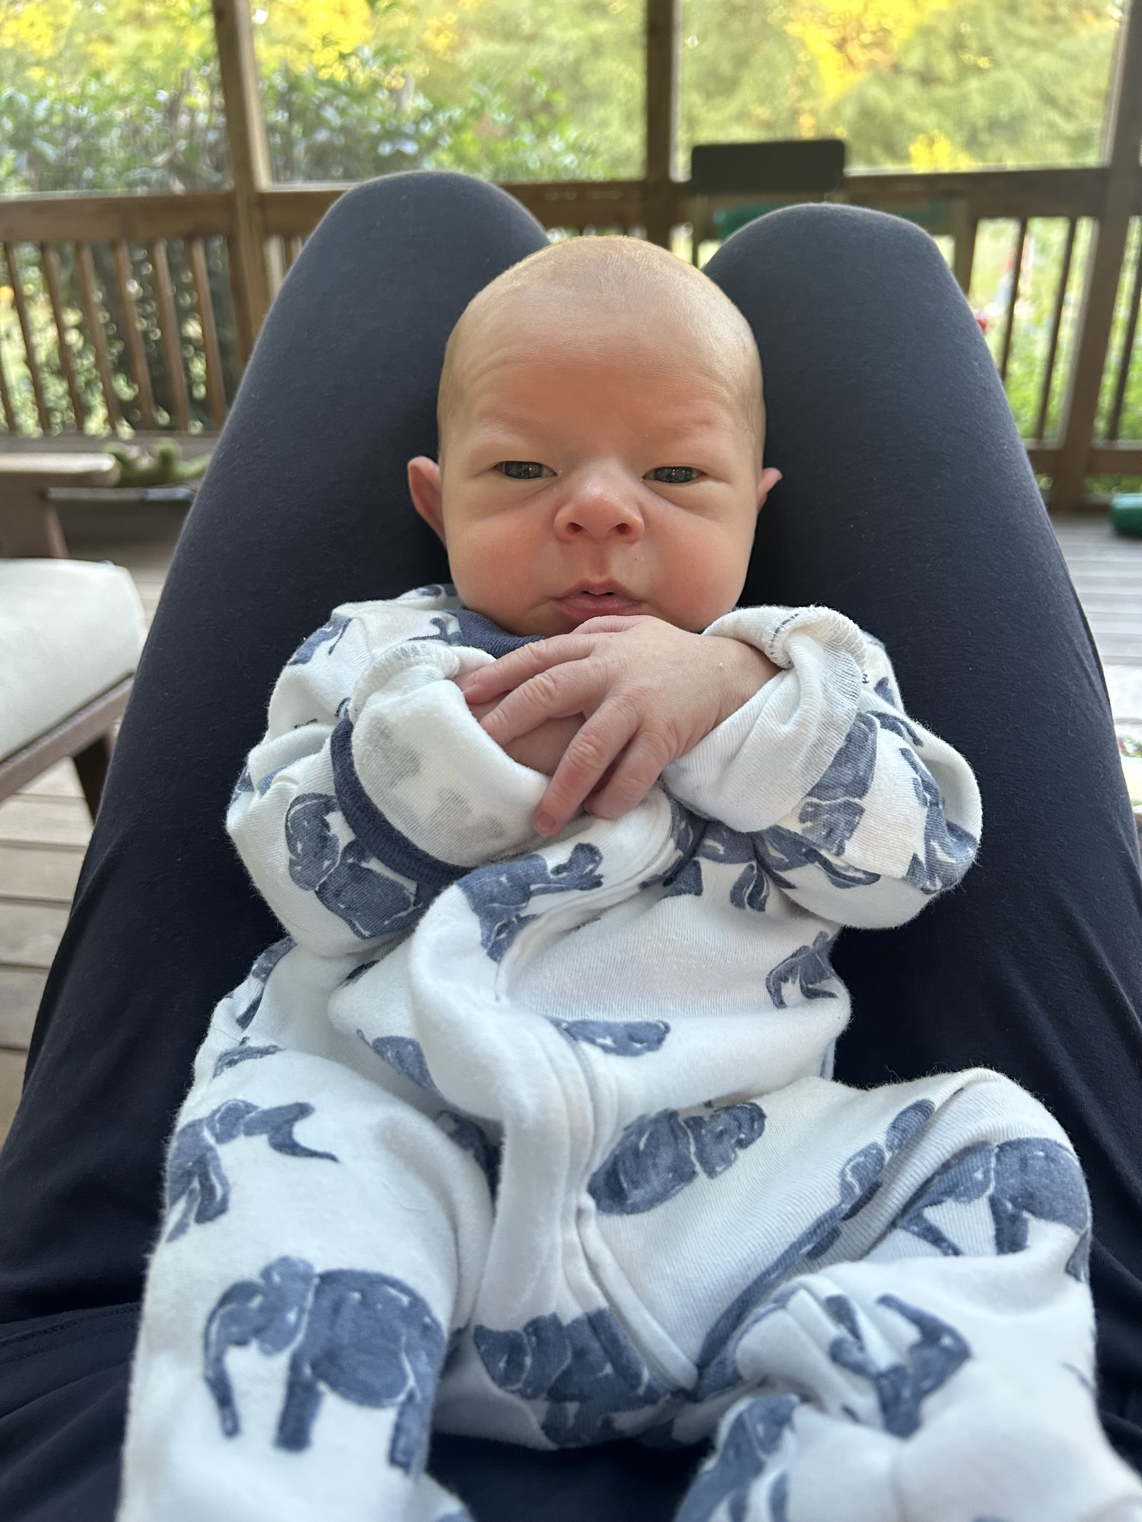
William Marcus Ryan – Sep 29, 2025

Slide 3
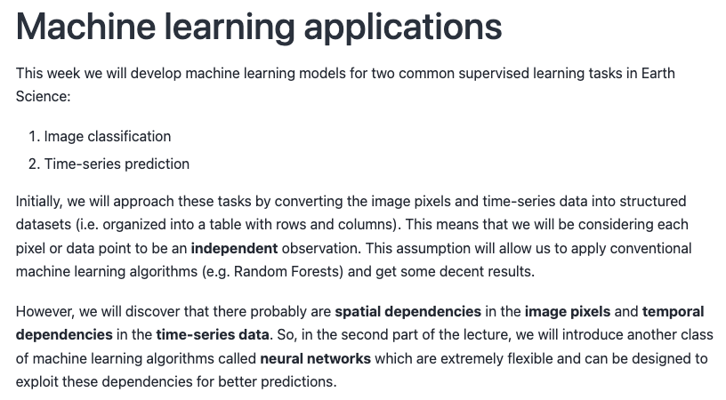

Slide 6
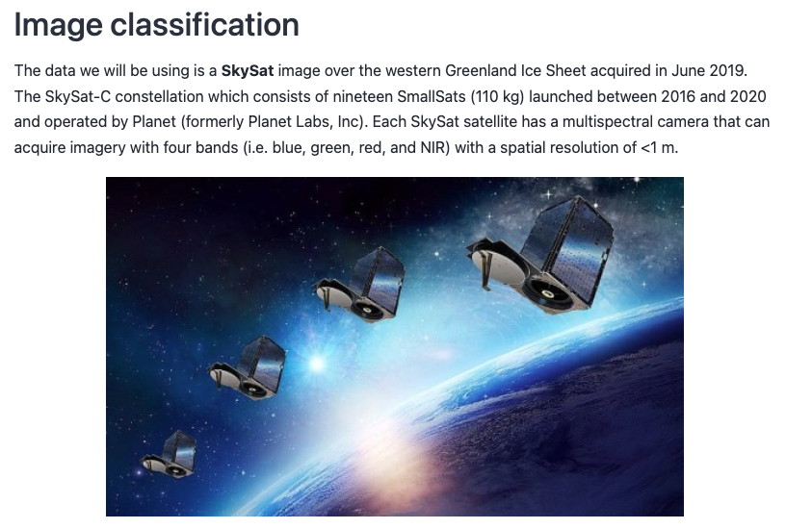

Slide 7
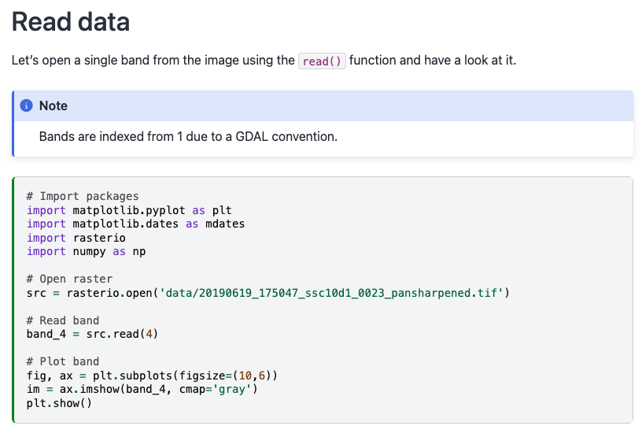

Slide 8
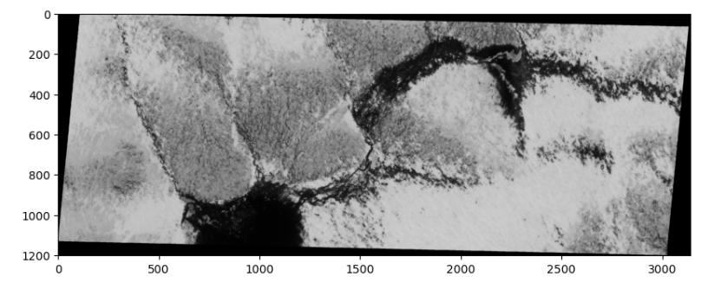

Slide 9
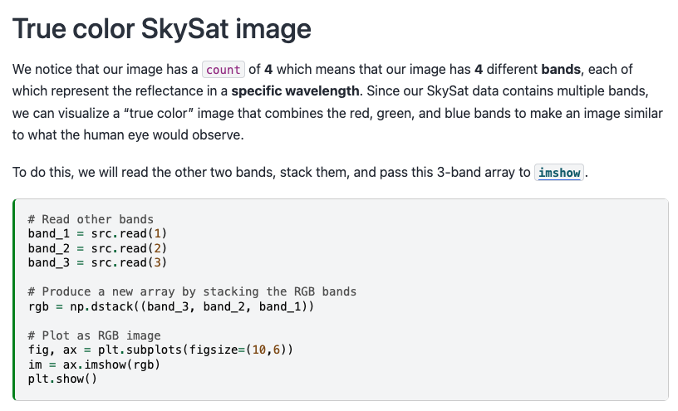

Slide 10
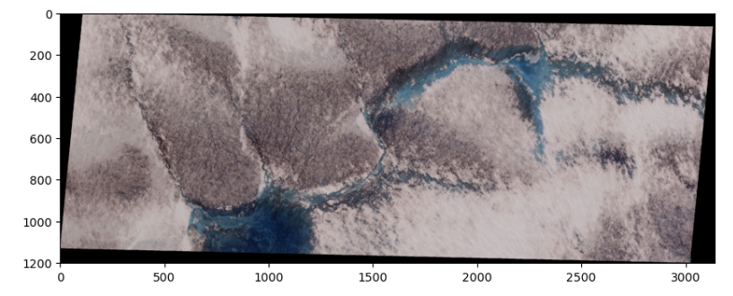

Slide 11


Slide 12
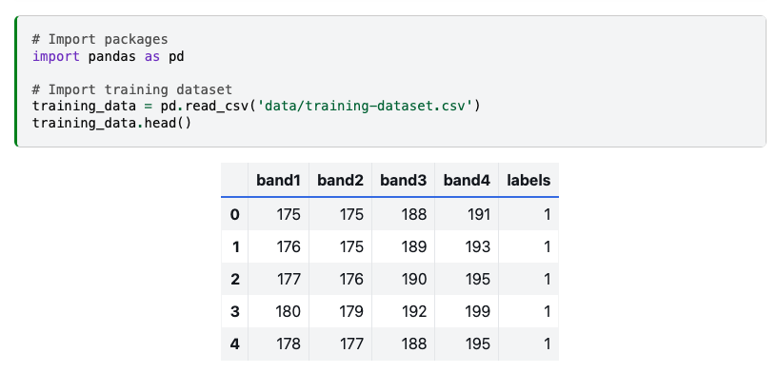

Slide 13
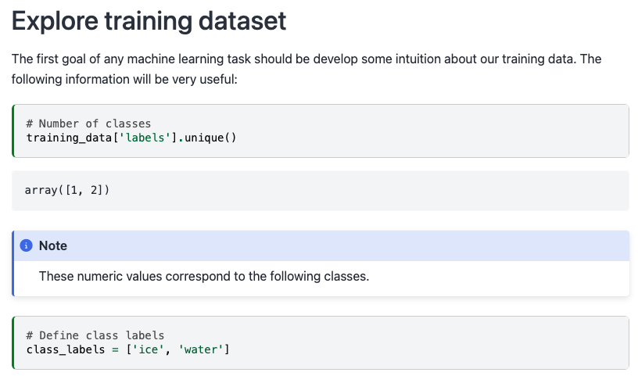

Slide 14
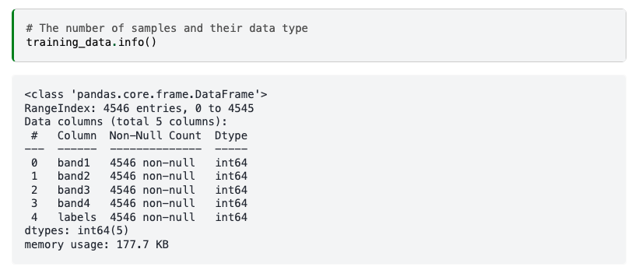

Slide 15
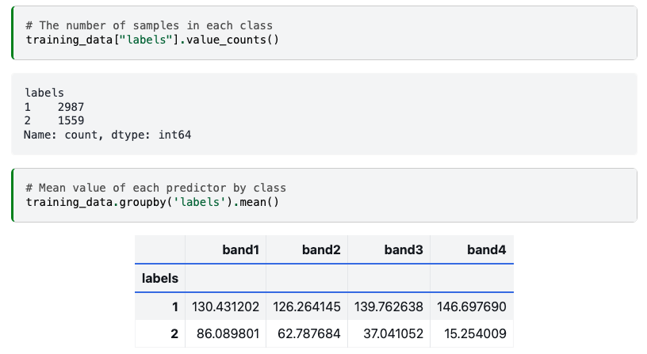

Slide 17
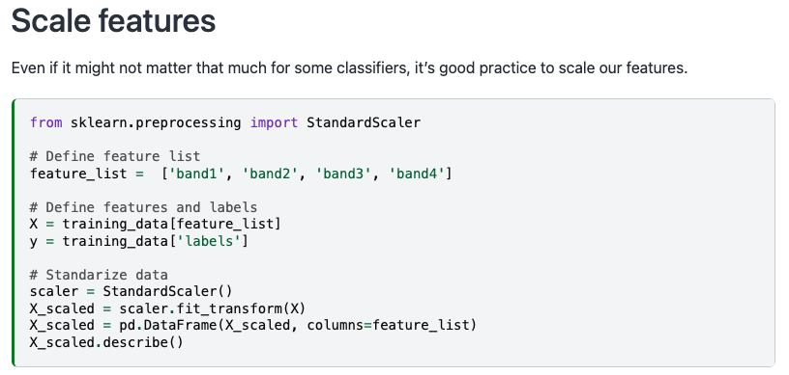

Slide 18
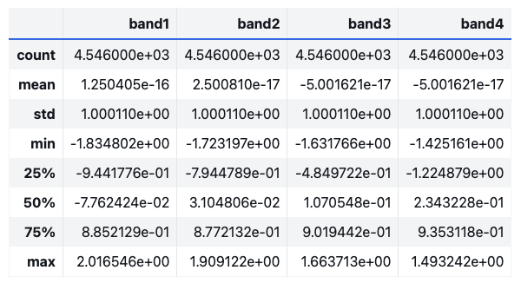

Slide 19
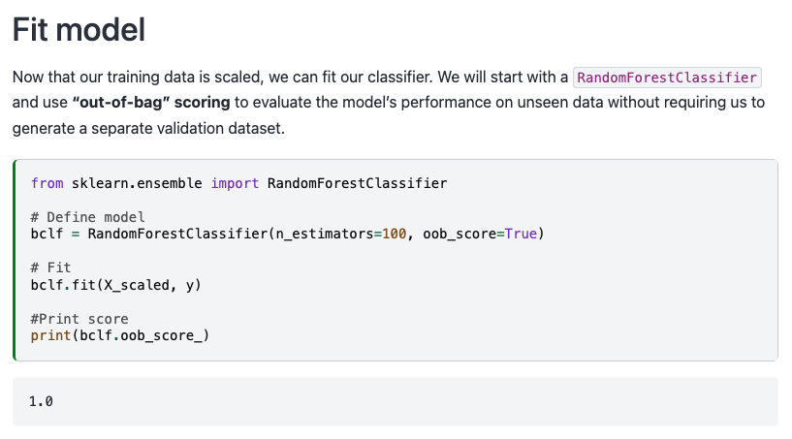

Slide 20
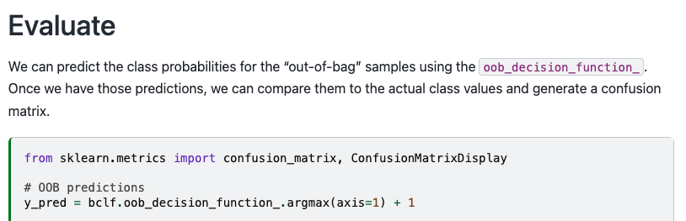

Slide 21
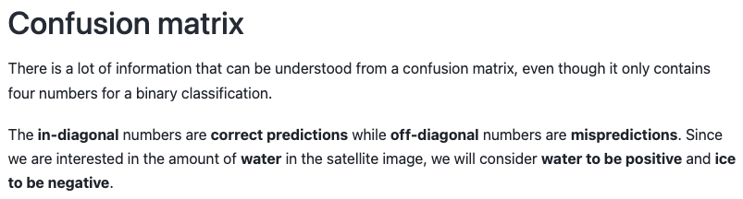
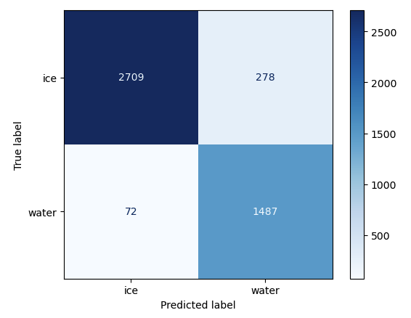

Slide 22
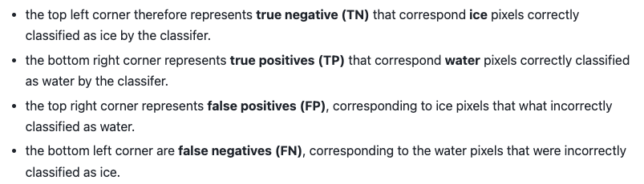
Notes:
Once we have split this information, we can compute metrics to investigate the generalization performance of our classifier in a particular setting. For instance, if our goal is to estimate the amount of water in the image, we might prefer to provide a lower-bound so we make statements such as “waters covers at least X% of the ice sheet”. This statement is a stronger scientific argument than “water covers up to X% of the ice sheet” which implies that it could also cover 0%.

Slide 23
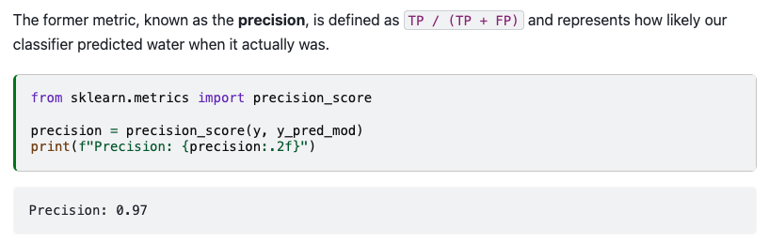

Slide 24
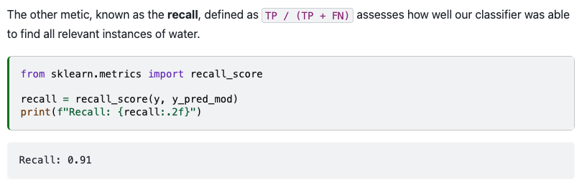

Slide 25
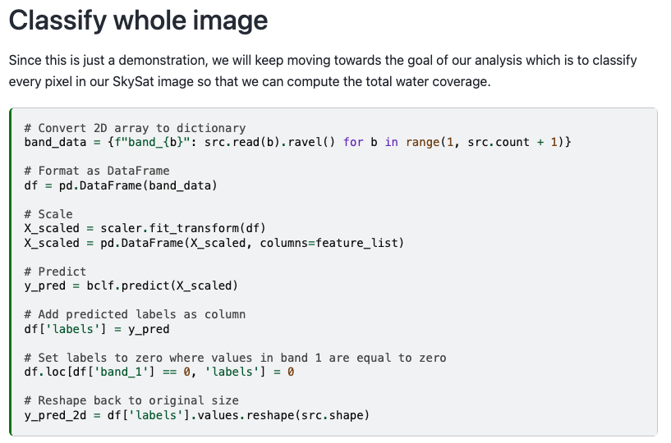

Slide 26
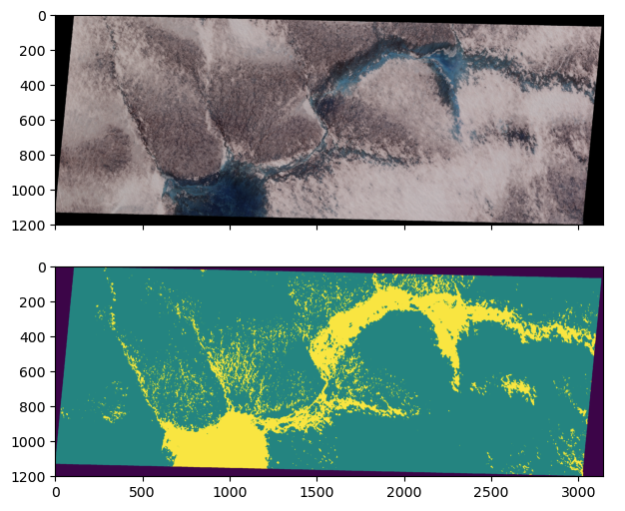
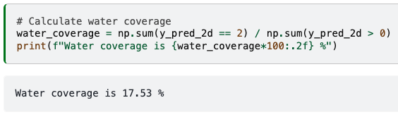

Slide 27
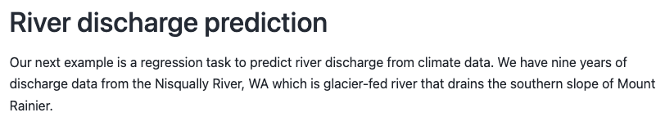
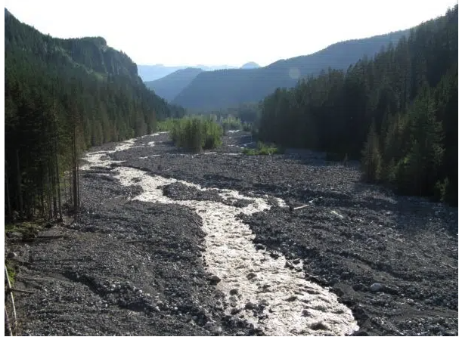

Slide 28
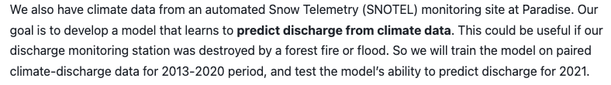
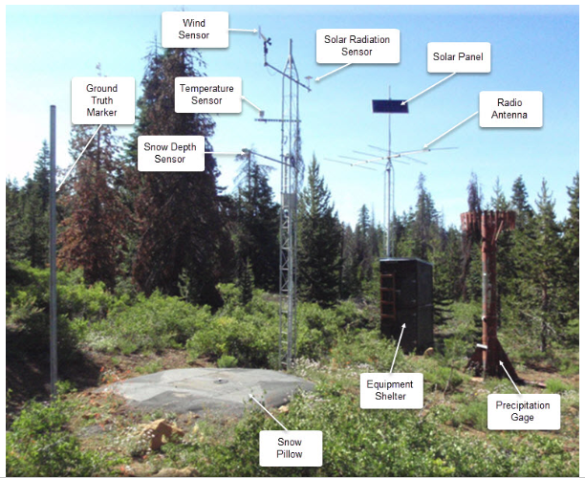

Slide 29
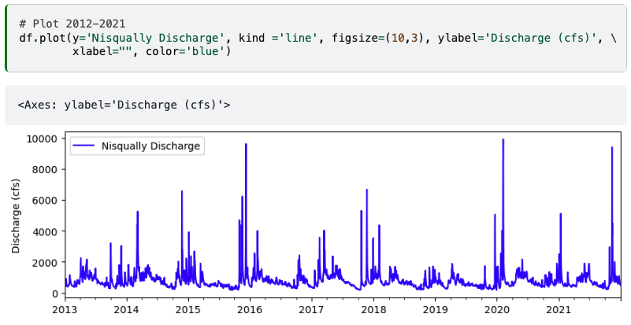

Slide 30
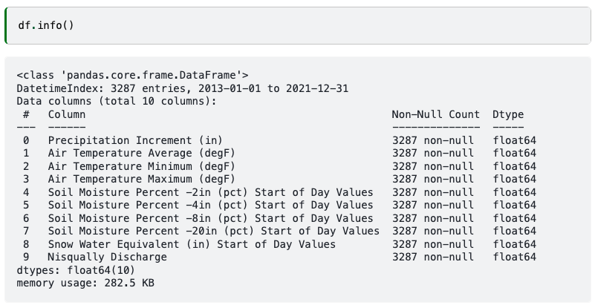
Notes:
The table contains daily data for nine different features including precipitation, air temperature, soil moisture, and snow water equivalent - all things that we might expect to have an influence on the discharge of the river. Exactly how these factors impact discharge would be challenging to model in a physically-based way. It would also depend on the characteristics of the watershed. Alternatively, we could build a model that learns the relationships between these factors and discharge directly from the data.

Slide 31
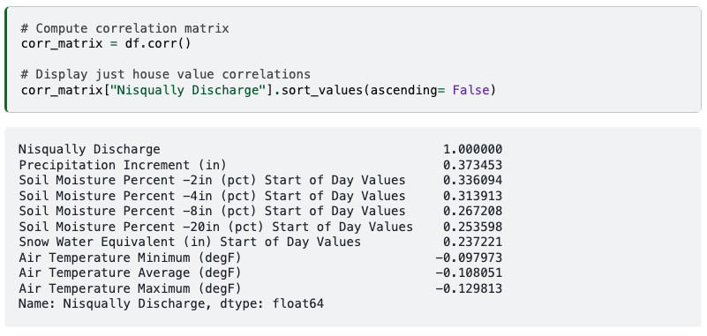

Slide 33
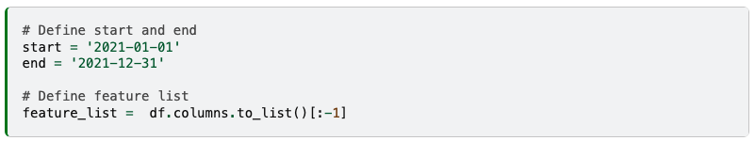

Slide 34
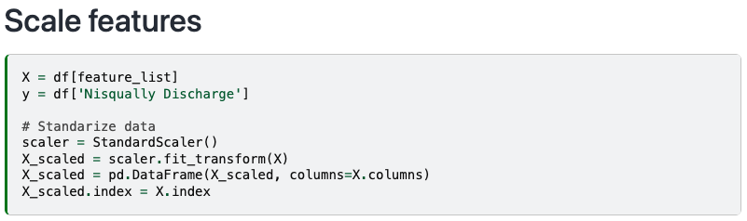

Slide 35
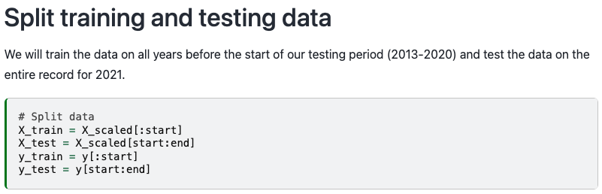

Slide 36
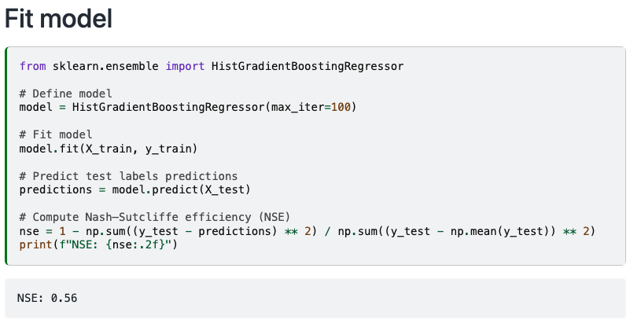

Slide 37
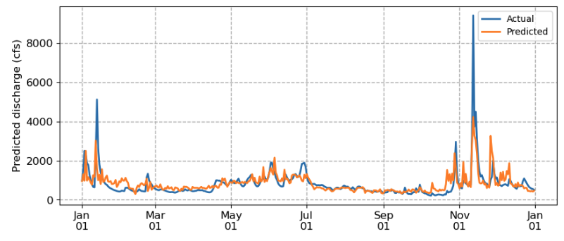
Notes:
We notice that the predicted discharge captures general patterns from high to low to high again. But it’s missing peaks in the discharge and it’s a also a little jagged, likely because it treats observations as independent. We are approaching the limits of conventional machine learning algorithms which cannot explicitly model temporal dependencies. For that, we need a different approach: neural networks.

Slide 38
ECS 351L and 851L : Geospatial Data Science
Lecture 6b: Neural networks
Email: jonathan.ryan@duke.edu
Office: 3101 Grainger Hall
Office hours: Mondays and Wednesdays 15:00-16:00

Slide 39
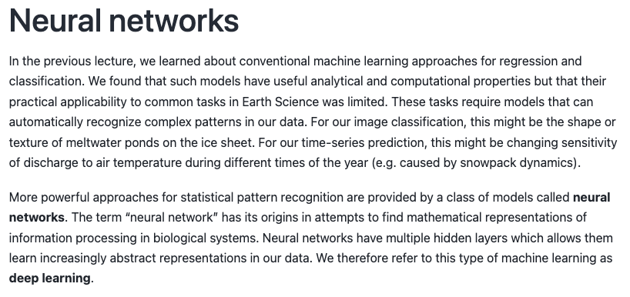

Slide 41
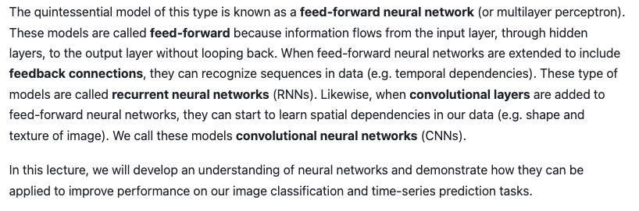
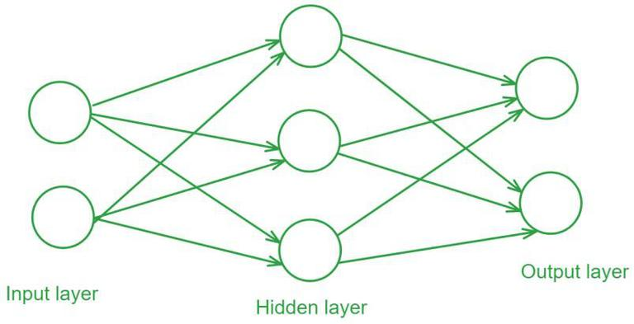

Slide 42

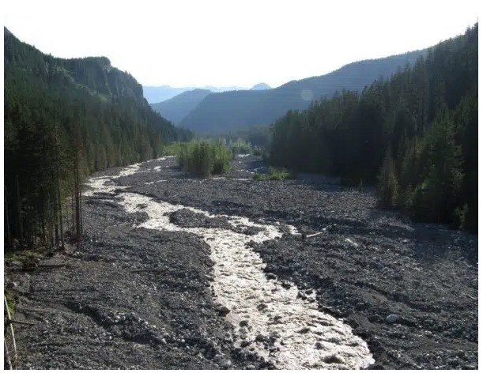
Notes:
Just like before, we will read our training dataset which contains climate data as features and discharge as the target variable.

Slide 43
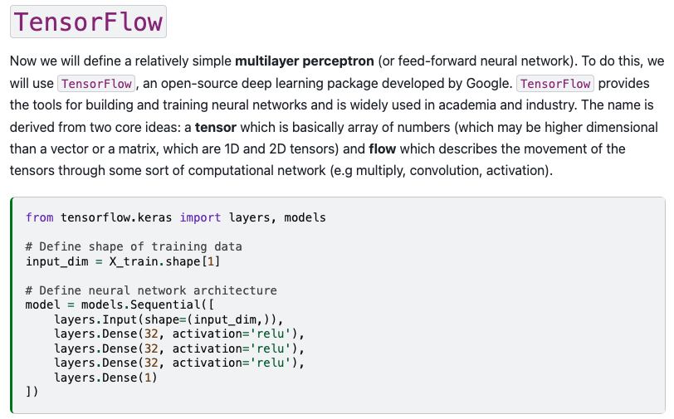

Slide 45
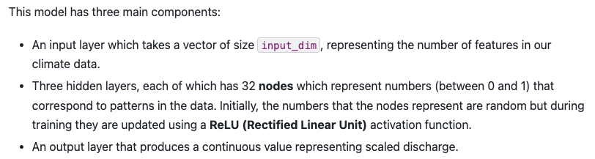

Slide 46
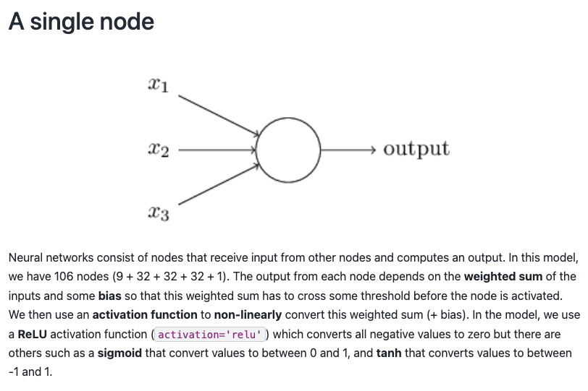

Slide 47
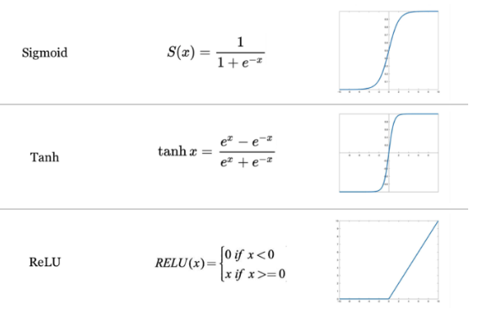

Slide 48
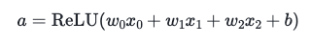

Slide 49
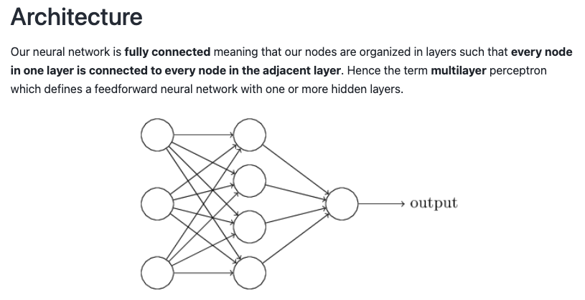

Slide 50
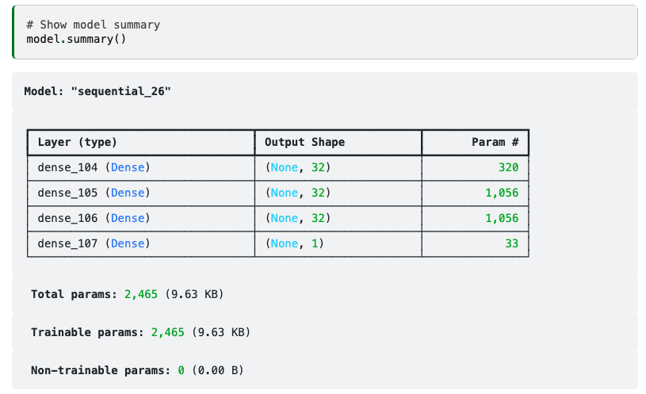

Slide 51
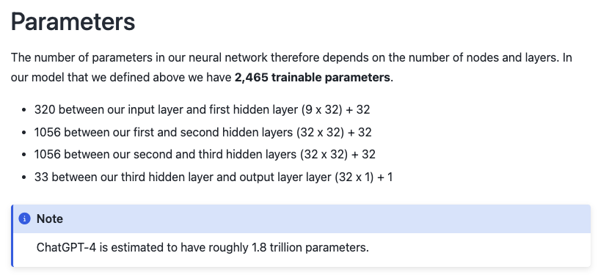

Slide 52
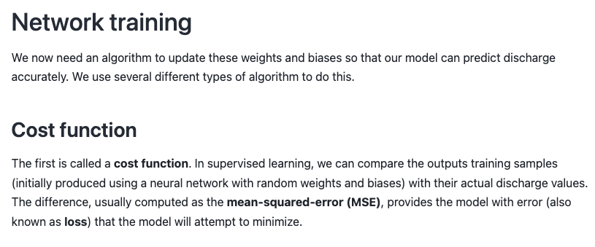
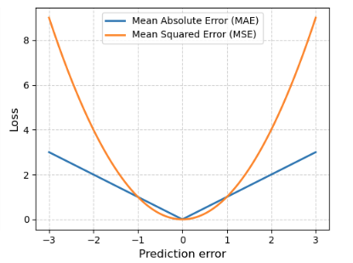

Slide 53
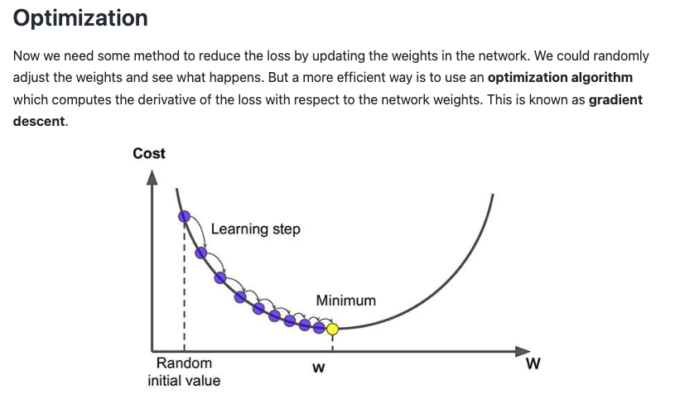

Slide 54


Slide 55


Slide 56



Slide 57


Slide 58


Slide 59


Slide 60


Slide 61


Slide 62

Notes:
We find a value that is slightly better than the 0.56 that we achieved with the Histogram Gradient Boosting (noting that higher value = better). Let’s plot the predicted vs actual discharge for 2021.

Slide 63


Slide 64

Notes:
We find that the validation error starts to increase after some number of epochs indicating that the model is overfitting because it is memorizing our dataset. This is perhaps not surprising given the flexibility (2,465 trainable parameters) of neural networks.

Slide 65


Slide 67


Slide 68


Slide 69


Slide 70


Slide 71


Slide 72
Next time: Specialized neural networks
Email: jonathan.ryan@duke.edu
Office: 3101 Grainger Hall
Office hours: Mondays and Wednesdays 15:00-16:00

